Slide 1
Ad Click Fraud Detection Using Machine Learning and Deep Learning Algorithm

Slide 2
CONTENTS OF THE PRESENTATION
Project Description.
Problem Statement.
Objective.
Scope.
Proposed System.
Architecture.
Resource Requirements.
Literature Review
Implementation
1. Data Description.
2. EDA Explanation.
3. Preprocessing steps.
Methodology.
Algorithm Implementation
Results
Modules
UML Diagrams.
Output Screens.
Future Scope.
Conclusion.
References

Slide 3
ABSTRACT
The rise of mobile advertising has led to an increase in fraudulent ad clicks, causing substantial financial losses to advertisers. This project presents a scalable and intelligent system for detecting ad click fraud using both Machine Learning and Deep Learning algorithms. The dataset contains key features such as IP address, application ID, device type, operating system version, publisher channel ID, click timestamp, and attribution time—whether a click resulted in an app download (is_attributed). A wide range of models were explored, including Logistic Regression, Decision Tree, Random Forest, K-Nearest Neighbors, SVM, Naive Bayes, Gradient Boosting, LightGBM, XGBoost, ANN, CNN, DNN, RNN, LSTM, and GRU. A Stacking Classifier was used to combine model strengths for optimal accuracy. The backend integrates these models for result comparison, while the Flask-based frontend allows users to input click details and receive real-time fraud detection results. This system provides a robust solution to improve ad campaign integrity.
Keywords: Ad Click Fraud, Machine Learning, Deep Learning, Flask App, Stacking Classifier, LSTM, XGBoost, Click Prediction, Mobile Advertising, Classification.

Slide 4
PROBLEM STATEMENT
In digital advertising, especially on mobile platforms, click fraud has emerged as a significant challenge. Fraudulent clicks—generated by bots or deceptive users—result in wasted advertising budgets, reduced ROI, and skewed analytics. Existing detection systems are often rule-based, static, or unable to generalize across diverse data. The problem addressed in this project is how to build a data-driven, intelligent, and adaptive system that can accurately classify ad clicks as fraudulent or genuine based on user behavior and device metadata. The solution must be scalable, robust, and deployable in real-time environments. The project seeks to use a variety of ML/DL models and compare their effectiveness in solving this issue while offering a deployable interface via a Flask web application.

Slide 5
OBJECTIVE
The main objective of this project is to build an efficient and intelligent system capable of detecting fraudulent ad clicks in real time. By analyzing various features such as IP address, app ID, device type, OS version, channel ID, click time, and attribution status, the goal is to classify whether a click is genuine or potentially fraudulent. This system utilizes a range of Machine Learning and Deep Learning models—including Logistic Regression, Random Forest, XGBoost, CNN, LSTM, and more—to ensure high accuracy and generalization. The model performance is compared, and the best-performing models are integrated into a user-friendly Flask web application. This enables users to input features manually and receive instant predictions on click legitimacy.

Slide 6
SCOPE
This project addresses the issue of click fraud in mobile advertising, focusing on the detection of fraudulent clicks before app attribution. It supports analysis and prediction using a combination of traditional ML models (e.g., Logistic Regression, Random Forest, XGBoost) and advanced deep learning architectures (e.g., CNN, LSTM, GRU). The solution includes backend training, evaluation of multiple models, and frontend deployment using Flask. The scope extends to model comparison, real-time fraud prediction, and system deployment in real-world advertising platforms. Future extensions may involve auto-updating models with live data, scaling for large-volume detection, and integration with ad networks or APIs to automate fraud prevention mechanisms efficiently.

Slide 7
MOTIVATION
Click fraud is a growing issue in the mobile advertising industry, where fraudulent actors simulate fake clicks to earn revenue unfairly. This not only impacts advertisers financially but also skews campaign performance metrics and undermines trust in digital marketing platforms. The motivation behind this project is to create a reliable system that helps advertisers and marketers detect fraudulent clicks accurately, thereby preventing unnecessary ad spend and improving campaign efficiency. By leveraging both machine learning and deep learning models, and deploying the solution with an easy-to-use interface, the project aims to bridge the gap between complex predictive analytics and practical usage. It empowers stakeholders with technology to mitigate digital ad fraud in an effective, automated manner

Slide 8
PROJECT INTRODUCTION
In today’s digital ecosystem, mobile advertising plays a crucial role in reaching targeted audiences efficiently. With the increasing shift toward app-based promotions and pay-per-click models, advertisers rely heavily on the accuracy and legitimacy of user interactions, especially ad clicks. However, the rise of click fraud—where bots or malicious users generate fake clicks—has become a significant threat. These fraudulent activities not only waste advertising budgets but also distort campaign performance metrics, leading to poor strategic decisions and reduced return on investment (ROI).
To address this growing issue, our project titled “Ad Click Fraud Detection Using Machine Learning and Deep Learning Algorithms” aims to build an intelligent fraud detection system that can automatically classify ad clicks as either genuine or fraudulent.

Slide 9
PROJECT INTRODUCTION
The system leverages a dataset containing key features such as IP address, app ID, device type, operating system version, channel ID, click timestamp, attributed download time, and a target label is_attributed which indicates whether a click resulted in a legitimate app download.
A wide range of algorithms is employed to ensure robustness and accuracy. Classical machine learning models like Logistic Regression, Decision Tree, Random Forest, K-Nearest Neighbors, Naive Bayes, SVM, Gradient Boosting, LightGBM, and XGBoost are implemented. In parallel, deep learning techniques such as Artificial Neural Networks (ANN), Convolutional Neural Networks (CNN), Recurrent Neural Networks (RNN), Long Short-Term Memory (LSTM), Gated Recurrent Unit (GRU), and Deep Neural Networks (DNN) are trained to capture hidden patterns and sequential behaviors in the data.

Slide 10
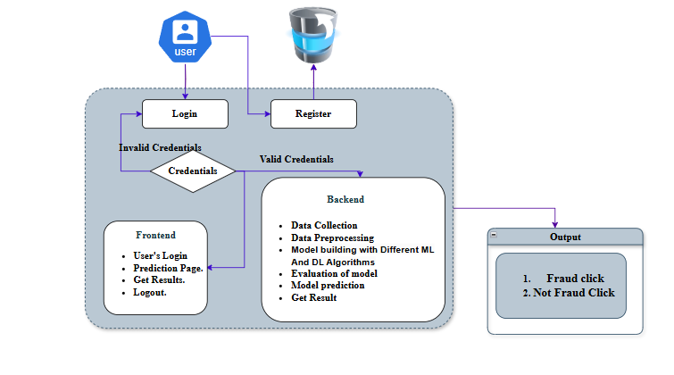
ARCHITECTURE

Slide 11
Existing System
The existing systems for ad click fraud detection rely on traditional Machine Learning and basic Deep Learning algorithms. Models like Logistic Regression, Decision Tree, Random Forest, K-Nearest Neighbors (KNN), Naive Bayes, and Support Vector Machine (SVM) are commonly used due to their simplicity and interpretability. Additionally, advanced techniques such as Gradient Boosting (GB), LightGBM, and XGBoost offer improved accuracy through ensemble learning. In the realm of deep learning, Artificial Neural Networks (ANN), Convolutional Neural Networks (CNN), Deep Neural Networks (DNN), and Recurrent Neural Networks (RNN) have been explored to capture non-linear and sequential patterns.While these methods provide reasonable performance, they often operate independently and struggle with complex temporal dependencies or require high tuning efforts. Moreover, they are limited in real-time adaptability and robustness when deployed on dynamic, large-scale advertising platforms.

Slide 12
Existing System
DISADVANTAGES:
Inability to capture long-term temporal dependencies (especially in RNN).
High risk of overfitting on imbalanced data.
Lower accuracy when applied to noisy or high-dimensional features.
Difficult to combine strengths of multiple models effectively.

Slide 13
Proposed System
To overcome the shortcomings of the existing models, the proposed system incorporates a hybrid approach using Stacking Classifier, LSTM, and GRU networks. The Stacking Classifier strategically combines multiple base learners (both ML and DL) to enhance generalization and predictive power through meta-learning. Simultaneously, Long Short-Term Memory (LSTM) and Gated Recurrent Unit (GRU) architectures are employed to learn sequential dependencies and capture time-based fraud patterns more effectively than standard RNNs. This combination ensures that both static features (like IP, device) and temporal features (like click time) are intelligently processed.The backend performs model training, cross-validation, and prediction generation, while a Flask-based frontend enables real-time fraud detection through user inputs. The proposed system thus ensures higher accuracy, robustness, and adaptability for detecting complex fraud behaviors in large-scale ad environments.

Slide 14
Proposed System
Advantages
Captures complex temporal behavior using LSTM and GRU.
Improves overall prediction accuracy with stacked ensemble learning.
Reduces overfitting through model diversity and regularization.
Adapts well to evolving fraud patterns and large datasets.
Supports real-time predictions via an intuitive web interface.

Slide 15
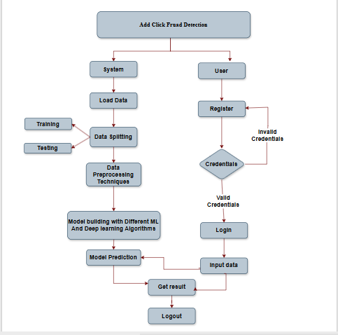
Project Flow

Slide 16
Resource Requirements
01
Hardware
(Processor: I5/Intel Processor, RAM: 8GB (min), Hard Disk: 128 GB, Key Board: Standard Windows Keyboard, Mouse: Two or Three Button Mouse)
Resources
02
Software
(Operating System: Windows 10, Programming Language: Python 3.10.8, IDE: VS Code)
03
Packages/Libraries
(Python, Flask, pandas, numpy, scikit-learn, Mysql,tensorflow

Slide 17
LITERATURE REVIEW
S. No. | Authors | Title & Source | Techniques Used | Key Findings / Highlights
[1] | Amreen Batool, Yungcheol Byun | An Ensemble Architecture Based on Deep Learning Model for Click Fraud Detection in Pay-Per-Click Advertisement Campaign, IEEE Access, 2022 DOI: 10.1109/ACCESS.2022.3211528 | CNN + BiLSTM with Random Forest Ensemble | Improved performance using spatial and temporal features; enhanced fraud detection accuracy in PPC campaigns.
[2] | Malak Aljabri, Rami Mustafa A. Mohammad | Click Fraud Detection for Online Advertising Using Machine Learning, Egyptian Informatics Journal, 2023 DOI: 10.1016/j.eij.2023.05.006 | Random Forest, LightGBM, XGBoost, MLP + LIME | Random Forest achieved ~95% accuracy; strong in imbalanced datasets; includes explainability through LIME.
[3] | Archana Purwar, Arti Jain, Indu Chawla, Divansh Jain | Click Fraud Detection Using Ensemble Classifier, Advances in Artificial-Business Analytics and Quantum Machine Learning, 2024 | RFE + Hellinger Distance Decision Tree (HDDT) | Ensemble classifier reached 99.72% accuracy on TalkingData dataset; superior to single classifiers.
[4] | Benjamin Kirkwood, Mounika Vanamala, Naeem Seliya | Click Fraud Detection of Online Advertising Using Machine Learning Algorithms, IEEE Electro InfoTech, 2024 | Feature Selection + Multiple ML Models | Highlights false positive challenges; focuses on dynamic ad environments and model robustness.
[5] | Qixuan Yu, Xirui Tang, Feiyang Li, Zinan Cao | Improved Adaboost Algorithm for Web Advertisement Click Prediction Based on LSTM, arXiv, 2024 URL: arXiv:2408.05245 | LSTM + Adaboost | Achieved 92% accuracy; outperforms standard models by 13%; strong temporal learning performance.

Slide 18
Implementation
Data Analysis
Model Implementation
01
Data Description
04
Algorithm Definition
02
EDA Explanation
05
Working Process
03
Preprocessing steps
06
Results from Algorithm

Slide 19
Algorithm Definition
Logistic Regression (LR)
Logistic Regression is a binary classification algorithm that models the probability of a click being fraudulent using a sigmoid function. It assumes a linear relationship between the input features and the log-odds of the output class. It is fast, interpretable, and effective on linearly separable data. In this project, it serves both as a baseline classifier and as a meta-learner in the stacking ensemble. Logistic Regression outputs class probabilities, which can be used to rank risks, making it a simple yet effective tool for initial fraud detection tasks.
Decision Tree (DT)
Decision Trees split data into subsets using feature-based conditions. Each internal node represents a decision rule, and each leaf node represents a class label. It is easy to interpret, supports non-linear patterns, and handles both numerical and categorical data. In fraud detection, Decision Trees can capture decision boundaries based on feature thresholds like device type or click time. However, they are prone to overfitting, especially on noisy data. In this project, DT serves as both a standalone model and a base learner within the stacking classifier to provide fast and rule-based predictions.

Slide 20
Algorithm Definition
. Random Forest (RF)
Random Forest is an ensemble of Decision Trees built using bootstrap sampling and random feature selection. It reduces overfitting by averaging predictions from many uncorrelated trees, improving accuracy and generalization. In this project, it efficiently handles high-dimensional clickstream data and captures non-linear interactions between features like device type, IP, and click timestamp. It is robust to noisy data and imbalanced classes, making it a strong performer in fraud detection. Additionally, Random Forest provides feature importance scores, helping interpret which variables influence fraud detection the most.
K-Nearest Neighbors (KNN)
KNN is a lazy learning algorithm that classifies a new sample by finding the majority class among its k-nearest data points in the training set. It uses distance metrics like Euclidean distance for comparison. KNN is simple and effective on small datasets with distinct class boundaries. In fraud detection, it helps identify patterns based on feature proximity, such as IP or time-based clusters of clicks. However, it can be computationally expensive for large datasets and sensitive to irrelevant features and scaling. Its simplicity makes it suitable for comparison and baseline evaluation in this project.

Slide 21
Algorithm Definition
Logistic Regression (LR)
Logistic Regression is a binary classification algorithm that models the probability of a click being fraudulent using a sigmoid function. It assumes a linear relationship between the input features and the log-odds of the output class. It is fast, interpretable, and effective on linearly separable data. In this project, it serves both as a baseline classifier and as a meta-learner in the stacking ensemble. Logistic Regression outputs class probabilities, which can be used to rank risks, making it a simple yet effective tool for initial fraud detection tasks.
Decision Tree (DT)
Decision Trees split data into subsets using feature-based conditions. Each internal node represents a decision rule, and each leaf node represents a class label. It is easy to interpret, supports non-linear patterns, and handles both numerical and categorical data. In fraud detection, Decision Trees can capture decision boundaries based on feature thresholds like device type or click time. However, they are prone to overfitting, especially on noisy data. In this project, DT serves as both a standalone model and a base learner within the stacking classifier to provide fast and rule-based predictions.

Slide 22
Algorithm Definition
Naive Bayes (NB)
Naive Bayes is a probabilistic classifier based on Bayes' theorem, assuming conditional independence between features. It computes the posterior probability of each class and selects the most likely one. Despite the independence assumption, it performs well on high-dimensional data and is computationally efficient. In this project, it’s applied to structured ad click data where rapid predictions are needed. Its simplicity and speed make it ideal for streaming data scenarios or as a lightweight model for comparison. Naive Bayes also works well with categorical and sparse features like app ID or OS version.
Support Vector Machine (SVM)
SVM is a margin-based classifier that finds the hyperplane that best separates two classes with maximum margin. It supports non-linear classification using kernel functions like RBF or polynomial kernels. SVM works well in high-dimensional spaces and is effective in fraud detection tasks where classes are separable. It can handle complex relationships among features like click sequence patterns or channel distributions. However, SVM can be slow on large datasets. In this project, it is used to benchmark performance against other models due to its solid theoretical foundation and ability to generalize well.

Slide 23
Algorithm Definition
Gradient Boosting (GB)
Gradient Boosting is an ensemble method that builds models sequentially, where each new model corrects the residual errors of the previous ones. It uses gradient descent to minimize the loss function. In this project, GB captures complex relationships in clickstream data by combining many weak learners, typically decision trees. It offers high accuracy but is sensitive to overfitting and hyperparameter tuning. Gradient Boosting is effective in scenarios with class imbalance and can model subtle fraud patterns. Its interpretability and performance make it a strong choice for fraud detection in ad campaigns.
LightGBM
LightGBM is a fast, high-performance gradient boosting framework designed for large datasets. It uses histogram-based algorithms and grows trees leaf-wise rather than level-wise, improving accuracy and speed. In this project, LightGBM handles high-dimensional click data with ease, offering superior performance on large-scale ad fraud datasets. It supports parallel learning, native categorical features, and regularization techniques, making it efficient and scalable. LightGBM is used both as a standalone model and as a base learner in the stacking ensemble due to its robustness, speed, and effectiveness in fraud classification tasks.

Slide 24
Algorithm Definition
XGBoost
XGBoost is an optimized gradient boosting algorithm known for its performance and scalability. It incorporates regularization (L1/L2), parallel processing, and missing value handling. In this project, XGBoost is one of the top-performing models, identifying fraudulent clicks by learning complex patterns in clickstream features. Its ability to handle noise, imbalanced data, and overfitting makes it suitable for real-world ad fraud scenarios. Additionally, XGBoost provides interpretable outputs through feature importance metrics. It is also used in the stacking ensemble for boosting overall accuracy and stability.
Artificial Neural Network (ANN)
ANNs are feedforward networks composed of input, hidden, and output layers, with each neuron applying a weighted sum followed by an activation function. They learn complex non-linear relationships in data. In this project, ANN is applied to model interactions between features like IP, device, app, and time. It provides better generalization than linear models but requires careful tuning and preprocessing. ANNs work well with structured data and can handle noise and variance. Their flexibility makes them a suitable choice for integrating multiple data features in fraud detection.

Slide 25
Algorithm Definition
Convolutional Neural Network (CNN)
CNNs are designed for spatial data like images, but they can be applied to structured data by reshaping it into 2D grids. They use convolutional filters to extract local patterns and pooling layers to reduce dimensions. In this project, CNN is used to model spatial relationships between engineered features. It identifies complex interactions among variables like app ID, timestamp, and channel in a structured way. CNNs are highly effective in automatic feature extraction and generalization, making them valuable for fraud classification with minimal manual feature engineering.
Deep Neural Network (DNN)
DNNs extend ANNs by stacking multiple hidden layers, allowing for the learning of more abstract and complex feature hierarchies. In this project, DNN is used to capture intricate relationships within high-dimensional click data. It enables deeper representation learning and performs well on large datasets with many input features. Although DNNs are prone to overfitting, proper regularization and dropout techniques mitigate this. Their versatility and ability to learn non-linear functions make DNNs suitable for modeling the diverse patterns seen in fraudulent and legitimate clicks.

Slide 26
Algorithm Definition
Recurrent Neural Network (RNN)
RNNs are designed to handle sequential data by maintaining hidden states that capture temporal dependencies. Each input is processed in a sequence, with output dependent on previous computations. In this project, RNN is used to model sequences of user click behaviors. RNNs are effective when fraud patterns depend on the order and timing of clicks. However, traditional RNNs suffer from vanishing gradient problems in long sequences. Despite this, they are useful for basic temporal modeling and serve as a foundation for more advanced models like LSTM and GRU.
Long Short-Term Memory (LSTM)
LSTM is a specialized RNN architecture that overcomes the limitations of traditional RNNs by introducing memory cells and gating mechanisms. It is capable of learning long-term dependencies and filtering irrelevant information. In this project, LSTM models user behavior over time, capturing sequences and timing of clicks to detect fraud patterns. LSTM helps identify coordinated or time-delayed fraudulent activities. It is well-suited for sequential fraud detection tasks where historical context significantly affects prediction outcomes.

Slide 27
Algorithm Definition
Gated Recurrent Unit (GRU)
GRU is a simplified version of LSTM that combines the forget and input gates into a single update gate. It retains the ability to learn sequential dependencies with fewer parameters, resulting in faster training. In this project, GRU processes time-ordered click data, learning behavioral sequences indicative of fraud. It strikes a balance between complexity and performance, making it ideal for real-time systems where quick decision-making and temporal learning are crucial.
Stacking Classifier
A Stacking Classifier is an ensemble learning technique that combines predictions from multiple base models to improve accuracy. In this project, Decision Tree, Random Forest, LightGBM, and XGBoost serve as base learners, while Logistic Regression acts as the meta-learner. This approach leverages the strengths of diverse models, reducing overfitting and improving generalization. Stacking is particularly effective when individual models capture different data aspects. It boosts overall system reliability, especially in imbalanced and complex fraud detection scenarios.

Slide 28
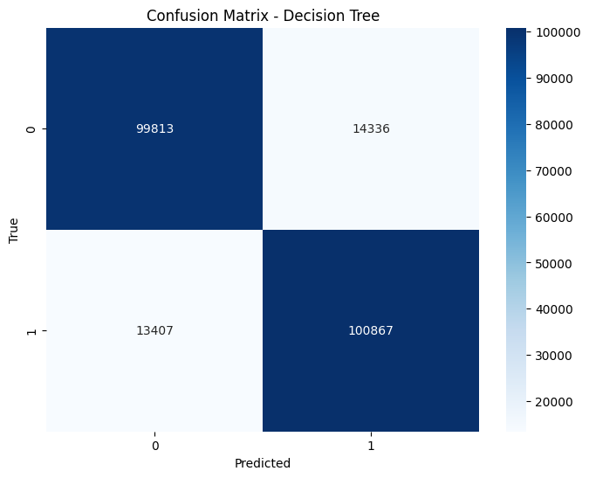
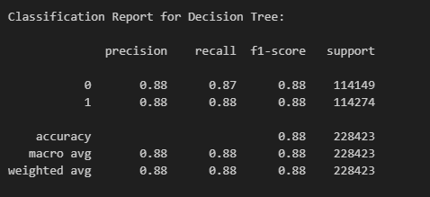
Results
Decision Tree
Figure: Confusion Matrix for DT
Figure: Classification Report for DT

Slide 29
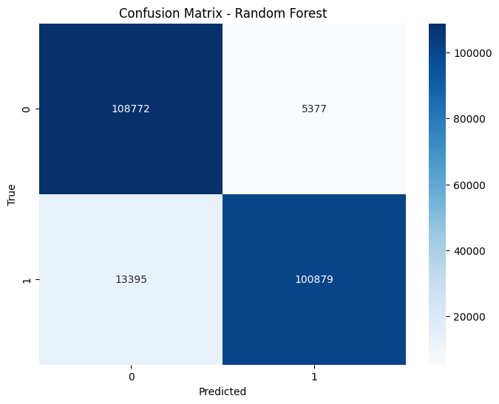
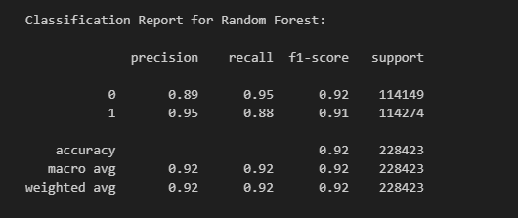
Results
Random Forest
Figure: Confusion Matrix for RF
Figure: Classification Report for RF

Slide 30

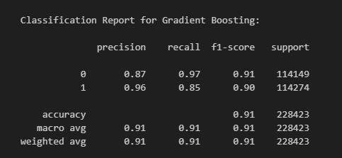
Results
Gradient Boosting
Figure: Confusion Matrix for GB
Figure: Classification Report for GB

Slide 31

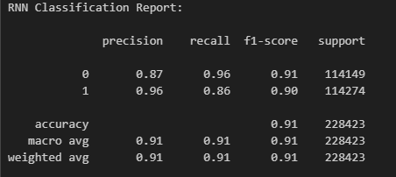
Results
RNN
Figure: Confusion Matrix for RNN
Figure: Classification Report for RNN

Slide 32
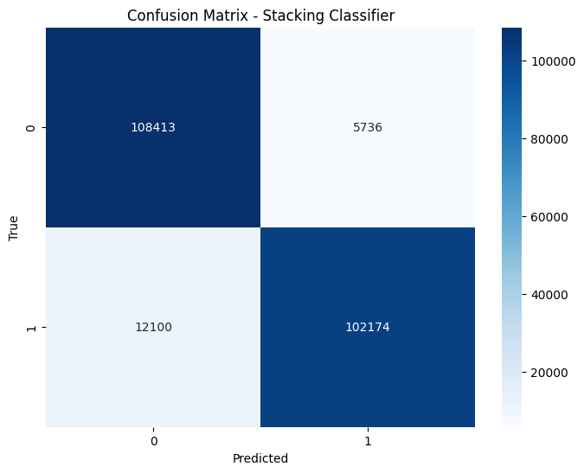
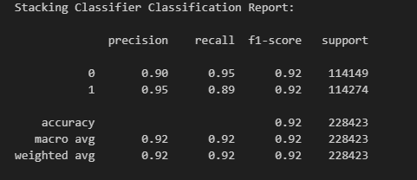
Results
Stacking Classifier
Figure: Confusion Matrix for RNN
Figure: Classification Report for RNN

Slide 33

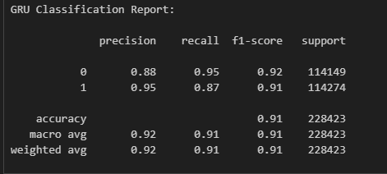
Results
GRU Classifier
Figure: Confusion Matrix for GRU
Figure: Classification Report for GRU

Slide 34
METHODOLOGY
1. Data Collection
Dataset Source: TalkingData AdTracking Fraud Detection dataset from Kaggle.
Content: The dataset consists of millions of ad click records with the following key features:
ip, app, device, os, channel, click_time, attributed_time
Target Variable: is_attributed (1 if the click led to an app download, 0 otherwise)
Total Columns: 8 (including label)
2.Data Exploration
Objective: Understand the dataset’s structure and quality.
Actions:
Load dataset into a Pandas DataFrame.
Use .info(), .shape, .head() to inspect structure, data types, and sample rows.
Check for missing values using .isnull().sum().
Use .describe() to generate summary statistics for numeric columns.
Visualize class distribution of is_attributed to detect class imbalance.
Plot histograms and bar charts for categorical features (app, device, channel, etc.) to assess distribution.
.

Slide 35
METHODOLOGY
4. Data splitting
5. Build a Dynamic Selection Hybrid Model
Implementation Workflow:
Define Base Classifiers:
Include a diverse set: Logistic Regression, Decision Tree, Random Forest, SVM, KNN, Naive Bayes, XGBoost, LightGBM, ANN, etc.
Step 1 – Train All Classifiers:
Train each classifier individually on the training data.
Compute Permutation Feature Importance (PFI) to assess each feature’s impact.
Step 2 – Select HEC (Half-Most Effective Classifiers):
Rank classifiers based on overall performance (accuracy, precision, recall, etc.).
Select the top 50% classifiers showing the highest performance and feature contribution.
Step 3 – Train & Evaluate Ensemble Methods:
Evaluate each ensemble using metrics like Accuracy, Precision, Recall, F1-Score, AUC.
.
6. Save the Model for Deployment
Use joblib or pickle for Machine Learning models, and model.save() for Keras-based Deep Learning models.
5. Build a Dynamic Selection Hybrid Model
Implementation Workflow:
Define Base Classifiers:
Include a diverse set: Logistic Regression, Decision Tree, Random Forest, SVM, KNN, Naive Bayes, XGBoost, LightGBM, ANN, etc.
Step 1 – Train All Classifiers:
Train each classifier individually on the training data.
Compute Permutation Feature Importance (PFI) to assess each feature’s impact.
Step 2 – Select HEC (Half-Most Effective Classifiers):
Rank classifiers based on overall performance (accuracy, precision, recall, etc.).
Select the top 50% classifiers showing the highest performance and feature contribution.

Slide 36
MODULES
System:
1. Data Collection:
This module is responsible for collecting ad click data from available datasets or live sources. The dataset includes essential features such as IP address, app ID, device type, OS version, channel ID, click time, and attribution time. The target variable indicates if the user downloaded the app post-click.
2.Data Preprocessing:
Raw data is often noisy or incomplete. This module handles missing values, encodes categorical variables, and scales numerical features. Timestamp fields like click_time are converted into meaningful features (hour, day, etc.) to improve model learning.
3.Splitting Data:
The dataset is split into training and testing sets to evaluate model generalization. Stratified splitting ensures class balance is maintained, which is especially important for imbalanced data like fraud detection.

Slide 37
MODULES
4.Model Training:
Multiple models including Logistic Regression, Decision Tree, Random Forest, KNN, ANN, SVM, XGBoost, LightGBM, CNN, RNN, LSTM, GRU, and Stacking Classifier are trained on the prepared training dataset using appropriate hyperparameters.
5. Model Evaluation:
Each trained model is evaluated using metrics like accuracy, precision, recall, F1-score, and ROC-AUC. This module compares model performance to identify the best candidates for deployment.
Model Prediction:
This module handles real-time predictions. It receives input features from users and applies the best-performing model(s) to predict whether a given ad click is fraudulent or legitimate.

Slide 38
MODULES
👤 User Modules
1.Login Page:
Allows registered users to securely log into the system using their email and password. Session management ensures secure and authenticated access to other parts of the application.
2.Registration Page:
New users can create an account by filling in required details like name, email, and password. Upon successful registration, users are redirected to the login page.
3.Upload Page:
Users can upload new datasets for training or testing purposes. The uploaded file is validated for format and structure before being processed for modeling.

Slide 39
MODULES
4.Model Page:
This page displays the performance of all trained models. Users can view evaluation as accuracy model for prediction tasks.
5.Prediction Page:
Provides an interface where users input features such as IP, app ID, device type, OS, channel, and click time. The model uses these inputs to predict whether the click is fraudulent or not and displays the result instantly.
6.Logout
To ensure data security and session integrity, the logout module allows users to safely end their session. When the logout option is selected, the system clears all active session data and redirects the user to the login page.

Slide 40
UML DIAGRAMS
UML stands for Unified Modelling Language. UML is a standardized general-purpose modelling language in the field of object-oriented software engineering. The standard is managed, and was created by, the Object Management Group.
The goal is for UML to become a common language for creating models of object-oriented computer software. In its current form UML is comprised of two major components: a Meta-model and a notation. In the future, some form of method or process may also be added to; or associated with, UML.

Slide 41
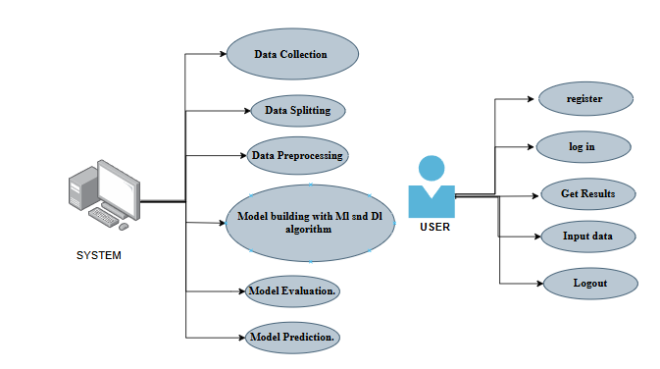
UML DIAGRAMS
A Use case diagram in the Unified Modeling Language (UML) is a type of behavioral diagram defined by and created from a Use-case analysis.

Slide 42
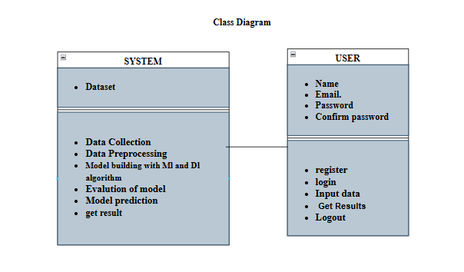
UML DIAGRAMS
A Class Diagram in the Unified Modeling Language (UML) is a type of static structure diagram that describes the structure of a system by showing the system's classes, their attributes, operations (or methods), and the relationships among the classes. It explains which class contains information.

Slide 43
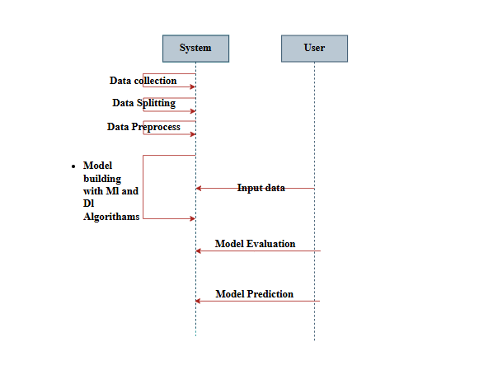
UML DIAGRAMS
A Sequence Diagram in Unified Modeling Language (UML) is a kind of interaction diagram that shows how processes operate with one another and in what order. It is a construct of a Message Sequence Chart. Sequence diagrams are sometimes called event diagrams, event scenarios, and timing diagrams.

Slide 44
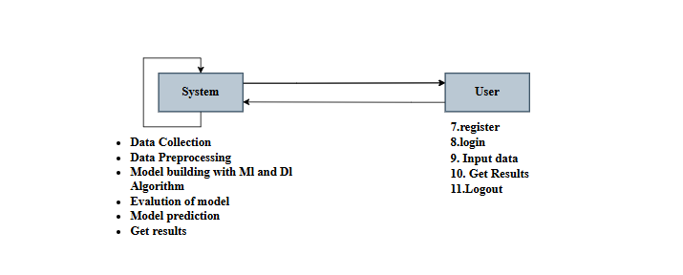
UML DIAGRAMS
In Collaboration Diagram the method call sequence is indicated by some numbering technique as shown below. The number indicates how the methods are called one after another. We have taken the same order management system to describe the collaboration diagram. The method calls are similar to that of a sequence diagram. But the difference is that the sequence diagram does not describe the object organization whereas the collaboration diagram shows the object organization.

Slide 45
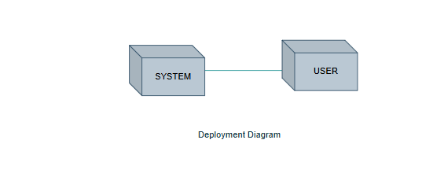
UML DIAGRAMS
A Deployment Diagram represents the deployment view of a system. It is related to the component diagram. Because the components are deployed using the deployment diagrams. A deployment diagram consists of nodes. Nodes are nothing but physical hardware’s used to deploy the application.

Slide 46
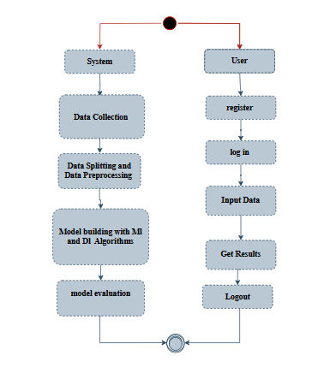
UML DIAGRAMS
Activity Diagrams are graphical representations of workflows of stepwise activities and actions with support for choice, iteration and concurrency. In the Unified Modelling Language, activity diagrams can be used to describe the business and operational step-by-step workflows of components in a system. An activity diagram shows the overall flow of control.

Slide 47
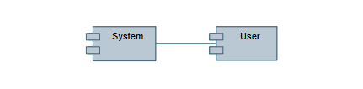
UML DIAGRAMS
A Component diagram, also known as a UML component diagram, describes the organization and wiring of the physical components in a system. Component diagrams are often drawn to help model implementation details and double-check that every aspect of the system's required function is covered by planned development.

Slide 48
UML DIAGRAMS
An Entity–relationship model (ER model) describes the structure of a database with the help of a diagram, which is known as Entity Relationship Diagram (ER Diagram). An ER model is a design or blueprint of a database that can later be implemented as a database. The main components of E-R model are: entity set and relationship set.
An ER diagram shows the relationship among entity sets. An entity set is a group of similar entities and these entities can have attributes. In terms of DBMS, an entity is a table or attribute of a table in database, so by showing relationship among tables and their attributes, ER diagram shows the complete logical structure of a database. Let’s have a look at a simple ER diagram to understand this concept.

Slide 49
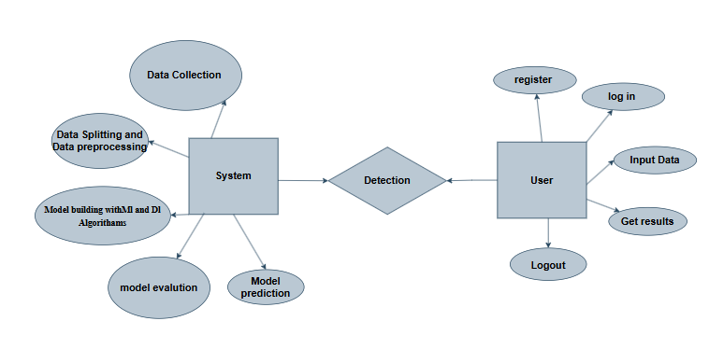
UML DIAGRAMS

Slide 50
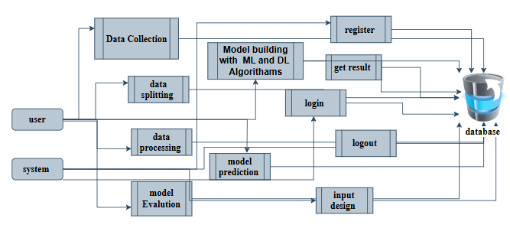
DFD DIAGRAMS
Level 1 Diagram

Slide 51
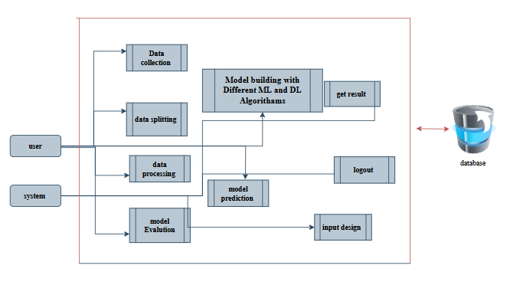
DFD DIAGRAMS
Level 2 Diagram

Slide 52
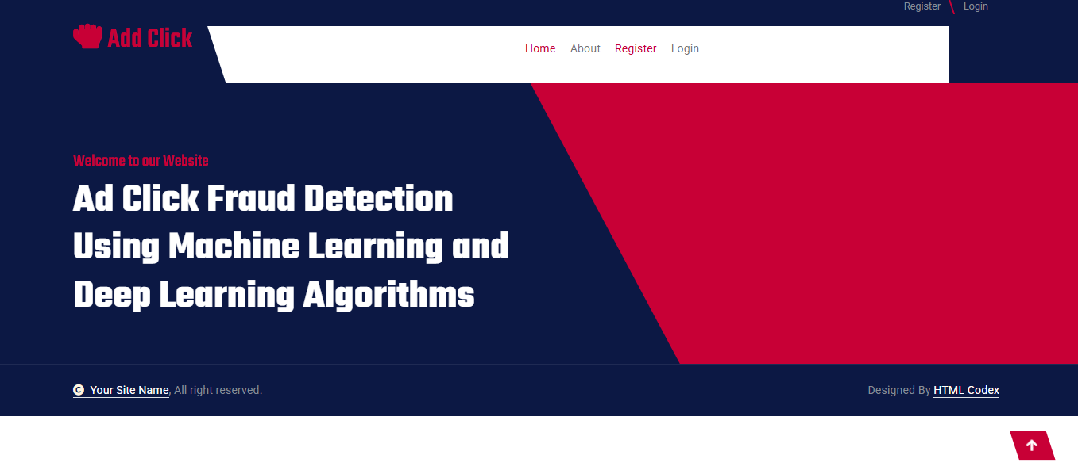
OUTPUT SCREENS
INDEX PAGE: This is the index page of the project website.

Slide 53

OUTPUT SCREENS
ABOUT PAGE: This page contains information about this website.

Slide 54
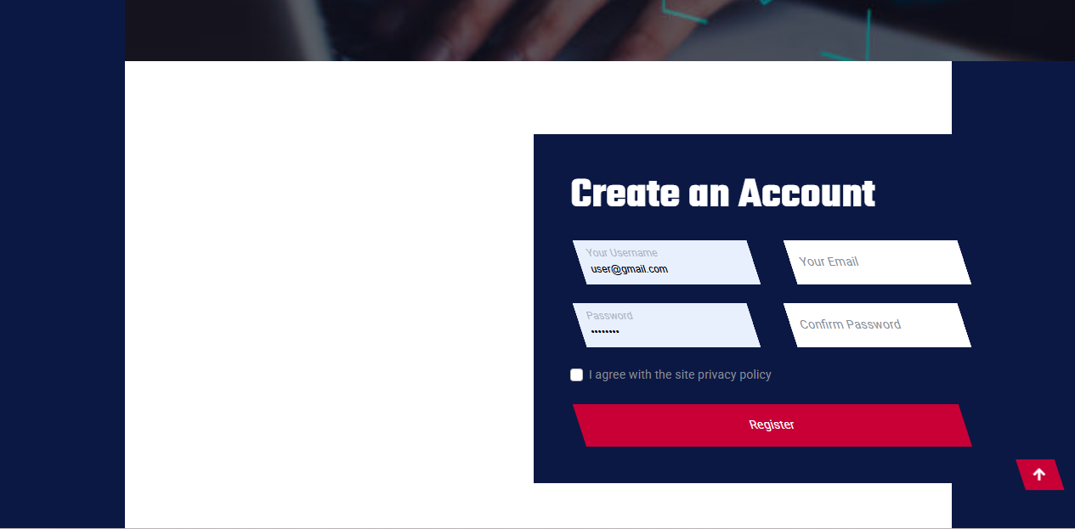
OUTPUT SCREENS
Registration Page: The Registration Page allows new users to create an account with the application

Slide 55
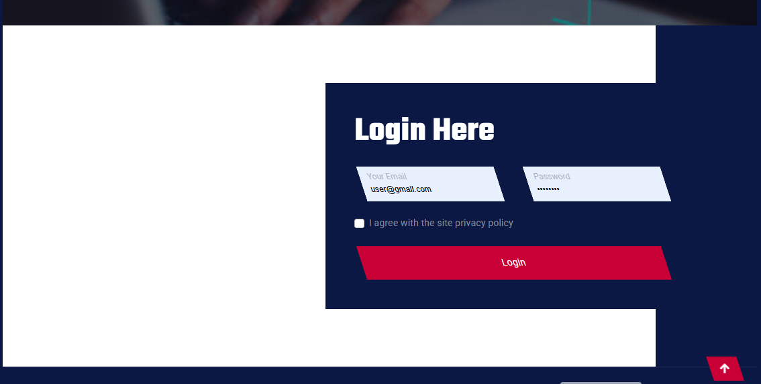
OUTPUT SCREENS
Login Page: The Login Page enables users to access their existing accounts by entering their credentials. It usually includes fields for entering a username/email and password

Slide 56
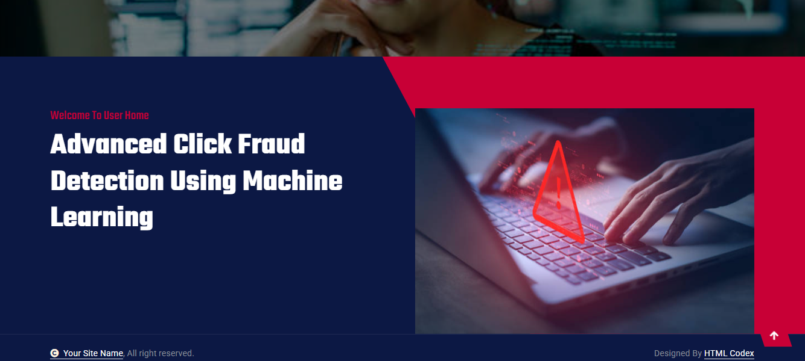
OUTPUT SCREENS
User home Page : After user successfully login this page will be appear

Slide 57
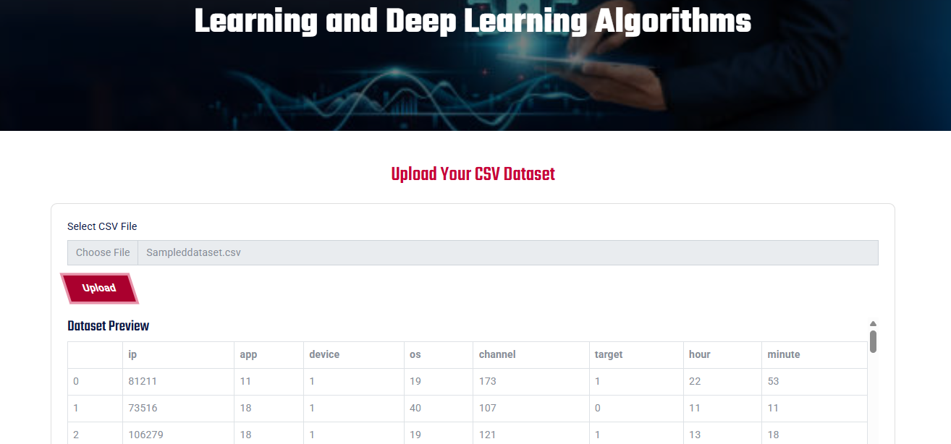
OUTPUT SCREENS
UPLOAD PAGE: It Will display dataset

Slide 58
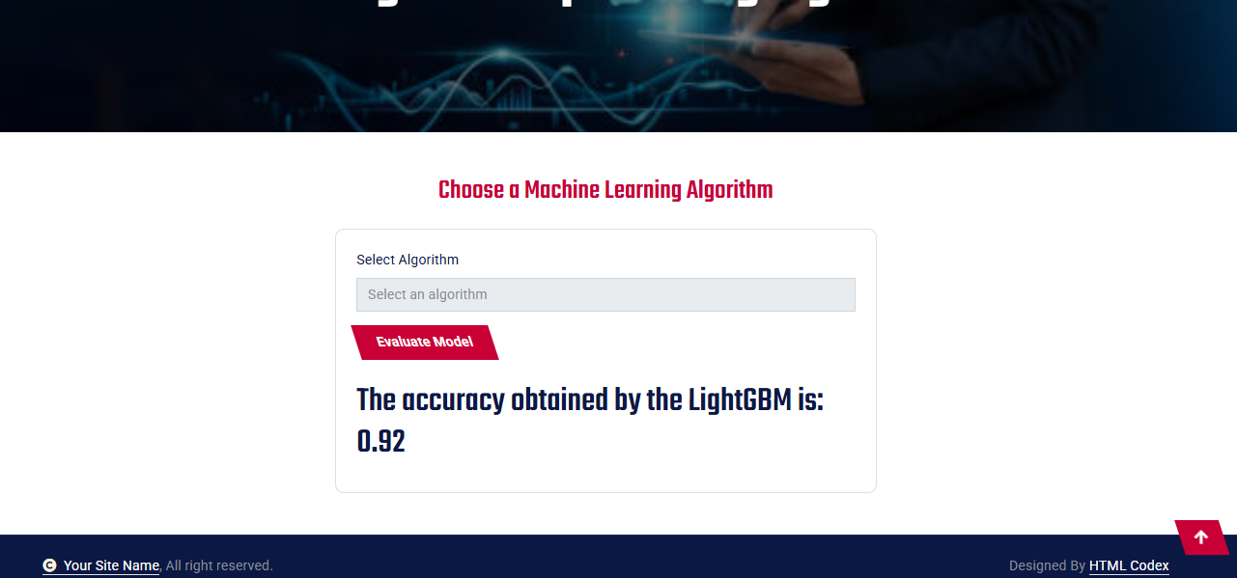
OUTPUT SCREENS
MODEL PAGE: It Will Show Accuracy of each models

Slide 59
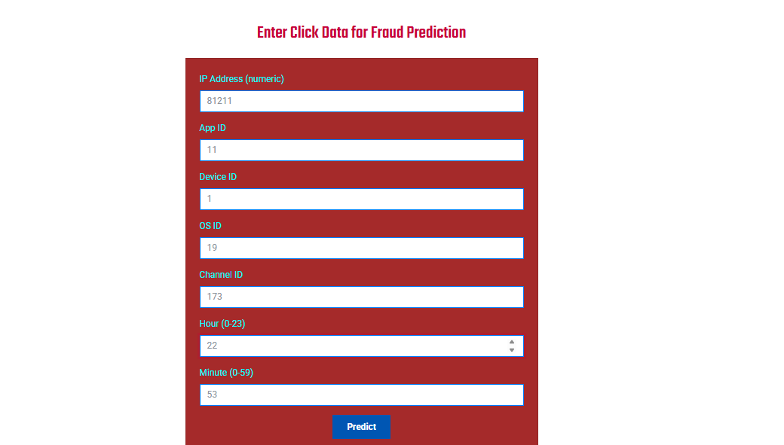
OUTPUT SCREENS
PREDICTION PAGE: In here user can give data and get prediction.

Slide 60
Future Scope
To further enhance the system's effectiveness and scalability, several improvements can be implemented in future iterations. Firstly, integrating explainable AI (XAI) techniques such as SHAP and LIME can provide users with deeper insights into why a particular click is classified as fraudulent, increasing trust in the system. Secondly, adding real-time integration with advertising platforms via APIs can automate fraud detection and flagging during live campaigns. Support for unsupervised anomaly detection algorithms would allow identification of previously unseen fraud patterns. Additionally, implementing adaptive learning would enable the system to continuously improve its accuracy as new data is collected. Multi-language support and advanced dashboard analytics can enhance usability for global stakeholders. Finally, deploying the system as a SaaS product on cloud platforms with load balancing and auto-scaling features would make it suitable for enterprise-level adoption. These enhancements will ensure that the system remains robust, adaptive, and industry-relevant in the evolving landscape of digital advertising fraud.

Slide 61
CONCLUSION
The Ad Click Fraud Detection System developed in this project demonstrates the powerful application of machine learning and deep learning techniques in identifying fraudulent ad clicks with high accuracy. By leveraging models such as Logistic Regression, Random Forest, XGBoost, LightGBM, CNN, LSTM, GRU, and ensemble stacking, the system effectively distinguishes between legitimate and fake clicks in real time. The integration of a Flask-based web interface ensures usability, making it accessible to advertisers and analysts for practical deployment. With robust input validation, real-time prediction, and confidence scoring, the platform enhances ad campaign transparency and return on investment. Furthermore, the project emphasizes efficiency by using open-source tools, resulting in a cost-effective and scalable solution. The system achieves its core objectives of fraud minimization, accuracy, and ease of use. Overall, the solution proves to be a reliable decision-support tool in digital marketing environments, helping stakeholders mitigate losses and optimize performance by preemptively filtering fraudulent activity.

Slide 62
REFERENCES
Alzahrani, R., Aljabri, M., & Mohammad, R. M. A. (2025). Ad Click Fraud Detection Using Machine Learning and Deep Learning Algorithms. IEEE Access. https://doi.org/10.1109/ACCESS.2025.3532200
Aljabri, M., & Mohammad, R. M. A. (2023). Click Fraud Detection for Online Advertising Using Machine Learning. Egyptian Informatics Journal, 24(3), 241–252. https://doi.org/10.1016/j.eij.2023.05.006
Batool, A., & Byun, Y. (2022). An Ensemble Architecture Based on Deep Learning Model for Click Fraud Detection in Pay-Per-Click Advertisement Campaign. IEEE Access, 10, 99234–99249. https://doi.org/10.1109/ACCESS.2022.3211528
Kirkwood, B., Vanamala, M., & Seliya, N. (2024). Click Fraud Detection of Online Advertising Using Machine Learning Algorithms. Proceedings of the IEEE International Conference on Electro Information Technology (EIT).

Slide 63
REFERENCES
Yu, Q., Tang, X., Li, F., & Cao, Z. (2024). Improved Adaboost Algorithm for Web Advertisement Click Prediction Based on Long Short-Term Memory Networks. arXiv preprint, arXiv:2408.05245. https://arxiv.org/abs/2408.05245
Purwar, A., Jain, A., Chawla, I., & Jain, D. (2024). Click Fraud Detection Using Ensemble Classifier. In Advances in Artificial-Business Analytics and Quantum Machine Learning (pp. 145–159). Springer.
Miotto, R., Wang, F., Wang, S., Jiang, X., & Dudley, J. T. (2018). Deep learning for healthcare: review, opportunities and challenges. Briefings in Bioinformatics, 19(6), 1236–1246.
He, K., Zhang, X., Ren, S., & Sun, J. (2016). Deep Residual Learning for Image Recognition. Proceedings of the IEEE Conference on Computer Vision and Pattern Recognition (CVPR), 770–778.

Slide 64
THANK YOU !

